Slide 1


Slide 2
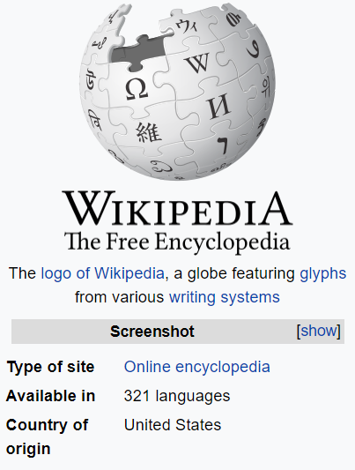
WIKIPEDIA
Multidomain
Multilingual
Freely accessible
Automatically evolving

Slide 3

DBpedia is a crowd-sourced community effort to extract structured information from Wikipedia and make this information available on the Web in the form of Linked Data.

Slide 4
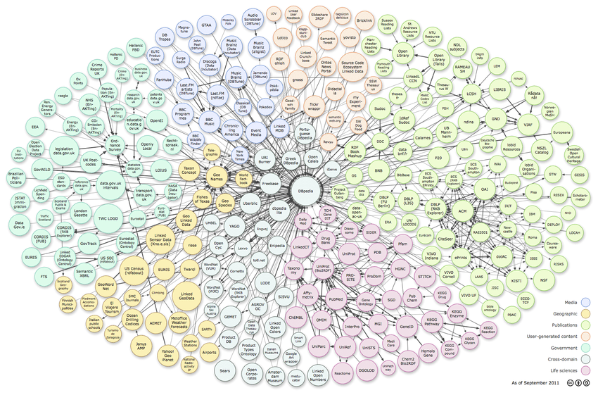
LINKED
DATA

Slide 5
A CLOSER LOOK
New York
location
PyLadies
Website link
http://www.pyladies.com/
Dublin
location
London
location
External link
type
Python Programming Language
Organization
location
Designer
type
type
type
Guido van Rossum
WAI
WWC
WIC
Notes:
Check the arrows

Slide 6
WHY
DBPEDIA?
Contains knowledge from Wikipedia
Semantics of information
Easily Accessible
Python wrapper available

Slide 7
Semantic query language to retrieve and manipulate data stored in RDF format.
S
P
A
R
Q
L
PARQL
rotocol
nd
DF
uery
anguage
Resource
Description
Framework
standard model for data interchange on the Web
Data Representation Format : Triple
subject predicate object
python type programming language
Notes:
Entity - attribute name – attribute value

Slide 8
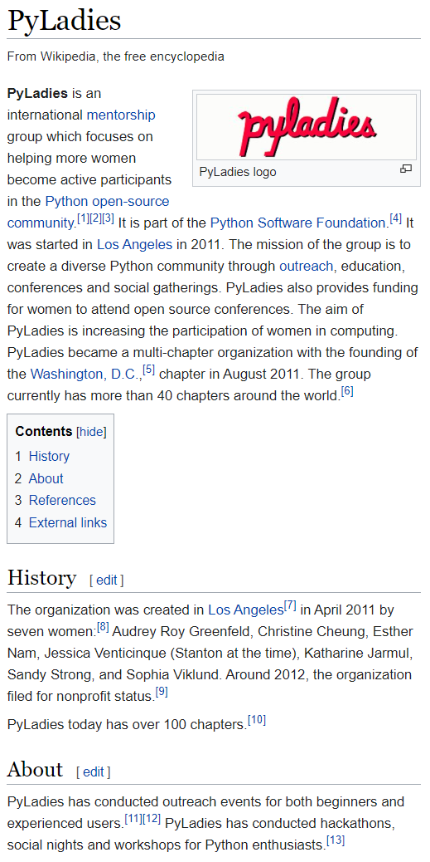
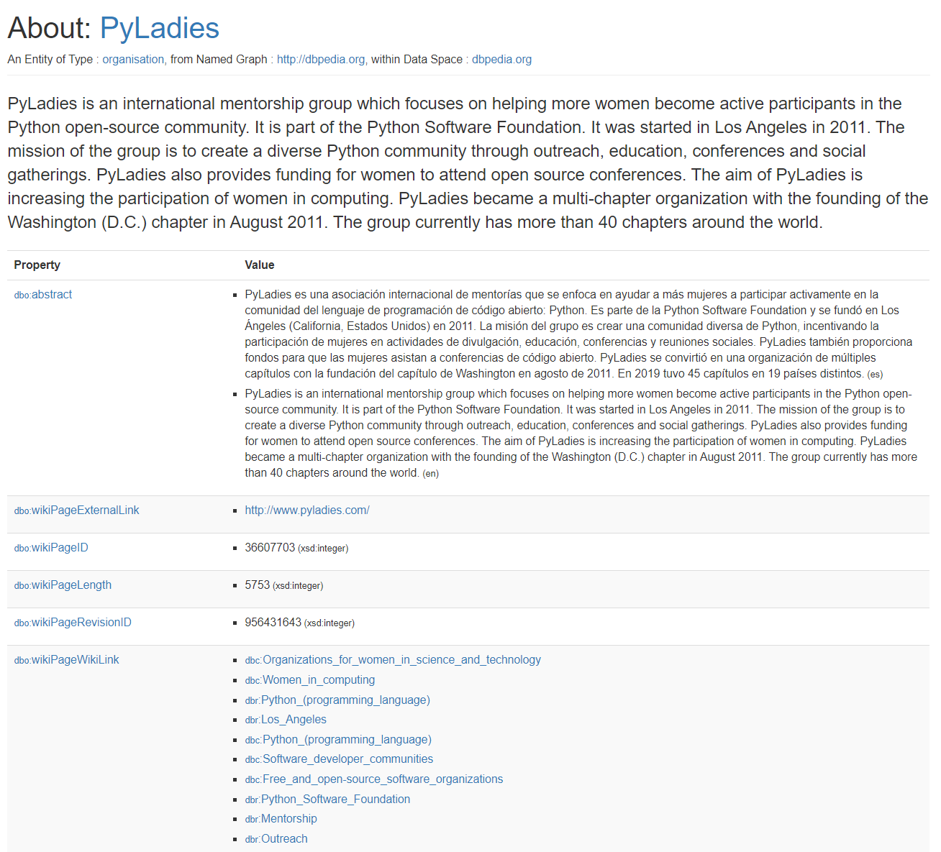
https://en.wikipedia.org/wiki/PyLadies
URI
URL
https://dbpedia.org/page/PyLadies
Vocabulary
DBO
DBR
FOAF
SKOS
Dublin Core

Slide 9
SPARQL
PREFIX foaf: <http://xmlns.com/foaf/0.1/>
PREFIX dbo: <http://dbpedia.org/ontology/>
PREFIX dbr: <http://dbpedia.org/resource/>
PREFIX dbp: <http://dbpedia.org/property/>
PREFIX ling: <http://purl.org/linguistics/gold/>
SELECT DISTINCT ?a, ?dob, ?ht, ?hpn, ?g, ?name, ?c, ?intro
WHERE
{
?a a dbo:Athlete; dbo:birthDate ?dob; dbo:height ?ht;
ling:hypernym ?hpn; foaf:gender ?g; foaf:name ?name; dbo:abstract ?intro.
OPTIONAL{?a dbo:country ?c}
FILTER(LANG(?name) = "en").
}
LIMIT 10000 OFFSET 0
PREFIX foaf: <http://xmlns.com/foaf/0.1/>
PREFIX dbo: <http://dbpedia.org/ontology/>
PREFIX dbr: <http://dbpedia.org/resource/>
PREFIX dbp: <http://dbpedia.org/property/>
SELECT DISTINCT ?a, ?dob, ?ht, ?name, ?c, ?intro
WHERE
{
?a a dbo:Athlete; dbo:birthDate ?dob; dbo:height ?ht;
foaf:name ?name; dbo:abstract ?intro.
OPTIONAL{?a dbo:country ?c}
FILTER(LANG(?name) = "en").
}
LIMIT 10000 OFFSET 0
PREFIX rdfs: <http://www.w3.org/2000/01/rdf-schema#>
SELECT
?entity, ?name
WHERE
{?entity rdfs:label ?name .}
SELECT
?subject, ?predicate, ?object WHERE
{ ?subject ?predicate ?object . }

Slide 10
DEMO

Slide 11
REFERENCES
Introduction to Linked Data: RDF Vocabularies (slideshare.net)
http://risis.eu/wp-content/uploads/2017/03/linked-data-sparql.pdf
Constructing SPARQL Queries. From simple queries to federated… | by Angus Addlesee | Wallscope | Medium

Slide 12
THANK YOU
QA

